Slide 1
Leveraging the expansive i.MX 8M Plus Family to Unlock New Opportunities
Sanjana Kubde
Product Marketing

Slide 2
i.MX 8M Plus Industrial Segment Applications
MPUs are used in industrial applications to manage high processing loads in real time, optimize power consumption and provide human machine interface (HMIs).
i.MX 8M Plus features perfect for this application segment,
Multicore Processing & Memory Interfaces
Quad/Dual Cortex A-53 @ 1.8GHz
Cortex-M7 @ 800 MHz
LPDDR4 up to 4.0GT/s
Machine Learning and Vision
Neural Processing Unit (NPU): Delivers up to 2.3 TOPS
Camera Interface: 2x MIPI CSI
Advanced Multimedia and Display
Video Processing Unit,
2D& 3D GPU,
MIPI-DSI, HDMI, LVDS
High Speed Interfaces
Ethernet w’/TSN, USB 3.0, PCIe, SDIO and CAN-FD
Operating Systems
Linux®, Android®, FreeRTOS

Slide 3
i.MX Portfolio – Features & Scalability - Confidential (NDA Required)
6x, A55, M7, 3xEth (2x w/TSN), 5x CAN-FD, ​
2x PCIe3, 3D GPU, VPU, Display/Camera, ​
NXP eIQ Neutron NPU, NXP ISP with RGB-IR support​
2-4x A53, M7, 2x Eth (1x TSN), 2x CAN-FD
2D and 3D GPU,
VPU, Camera/Display, NPU, ISP
i.MX 95
Performance
i.MX 8MP
New i.MX 8M Plus variant targets the Industrial segment with the following features:
4x Cortex-A53, 2D and 3D GPUs, VPU, and NPU
No ISP and HiFi-4 DSP
High industrial reliability with DRAM inline ECC
Display Interfaces:
4-lane MIPI-DSI,
8-lane LVDS,
HDMI 2.0
High Speed Interfaces:
2x Gigabit Ethernet (1x w/ TSN)
2x USB 3.0/2.0 Dual-Role with PHY type C
2x CAN/CAN-FD
1x PCIe Gen 3
i.MX 8M Plus new variant
2-4x A53, M7, 2x GbE,
2D and 3D GPU,
Camera/Display, VPU, NPU
i.MX 8MM
2xA55, M33, 2xEth (1x TSN),
2x CAN-FD, 2D: PXP,
Display/Camera, NPU
i.MX 8MN
1-4x A53, M4, 1x Eth,
2D and 3D GPU,
Camera/Display, VPU
i.MX 93
1-4x A53, M7, 1x Eth,
GPU, Camera/Display
i.MX 8ULP
i.MX 91
2xA35, M33, 1xEth, 1x CAN-FD,
2D and 3D GPU, Display/Camera
1xA55, 2xEth (1x TSN), 2x CAN-FD,
24-bit RBG Display/8-bit YUV/RGB Camera
Low
Low-mid
Mid
Mid-high
High
$
Notes:
Updated slide – Sai to give

Slide 4
i.MX 8M Plus New Variants
Part Number | Sub Family | Application Requirements | Arm CPU | NPU | ISP | Video | HiFi4 DSP | Temp (C) | CAN-FD | Family Common Features
MIMX8ML8DVNLZAB | i.MX 8M Plus Quad | Machine Learning, Vision & Video | 4x Cortex-A53 Up to 1.8GHz | 2.3 TOPS | 12MP resolution Up to 375MP/s | Decode: 1080p60 (h.265/4, VP8/9) Encode: 1080p60 (h.265/4) | YES | 0 - 95 | 2X CAN | Cortex-M7 @800MHz GPU OpenVG 1.1, G2D, OpenGL ES3.1 Vulkan, OpenCL 1.2 FP Display/Camera HDMI Tx, LVDS, MIPI-DSI 2X MIPI-CSI Connectivity 2x USB 3.0, PCIe Gen3 2x Gb Ethernet (1x TSN) 3x SDIO Audio 18x I2S TDM (32b@768KHz) S/PDIF Rx & Tx, eARC ASRC, 8ch PDM
MIMX8ML8CVNKZAB | i.MX 8M Plus Quad |  | 4x Cortex-A53 Up to 1.6GHz |  |  |  |  | -40 - 105 | 2X CAN-FD
MIMX8ML6DVNLZAB | i.MX 8M Plus Quad | Vision &Video | 4x Cortex-A53 Up to 1.8GHz | _ | 12MP resolution Up to 375MP/s | Decode: 1080p60 (h.265/4, VP8/9) Encode: 1080p60 (h.265/4) | _ | 0 - 95 | 2X CAN
MIMX8ML6CVNKZAB | i.MX 8M Plus Quad |  | 4x Cortex-A53 Up to 1.6GHz |  |  |  |  | -40 - 105 | 2X CAN-FD
MIMX8ML5DVNLZAB | i.MX 8M Plus Quad | Machine Learning & Video | 4x Cortex-A53 Up to 1.8GHz | 2.3 TOPS | - | Decode: 1080p60 (h.265/4, VP8/9) Encode: 1080p60 (h.265/4) | - | 0 - 95 | 2X CAN
MIMX8ML5CVNKZAB | i.MX 8M Plus Quad | Machine Learning & Video | 4x Cortex-A53 Up to 1.6GHz | 2.3 TOPS | - | Decode: 1080p60 (h.265/4, VP8/9) Encode: 1080p60 (h.265/4) | - | -40 - 105 | 2X CAN-FD
MIMX8ML4DVNLZAB | i.MX 8M Plus QuadLite | Compute & High-speed Industrial Interfaces | 4x Cortex-A53 Up to 1.8GHz | _ | _ | _ | _ | 0 - 95 | 2X CAN
MIMX8ML4CVNKZAB | i.MX 8M Plus QuadLite |  | 4x Cortex-A53 Up to 1.6GHz |  |  |  |  | -40 - 105 | 2X CAN-FD
MIMX8ML3DVNLZAB | i.MX 8M Plus Dual | Machine Learning, Vision & Video | 2x Cortex-A53 Up to 1.8GHz | 2.3 TOPS | 12MP resolution Up to 375MP/s | Decode: 1080p60 (h.265/4, VP8/9) Encode: 1080p60 (h.265/4) | YES | 0 - 95 | 2X CAN
MIMX8ML3CVNKZAB | i.MX 8M Plus Dual |  | 2x Cortex-A53 Up to 1.6GHz |  |  |  |  | -40 - 105 | 2X CAN-FD
MIMX8ML2DVNLZAB | i.MX 8M Plus Dual | Machine Learning & Video | 2x Cortex-A53 Up to 1.8GHz | 2.3 TOPS | - | Decode: 1080p60 (h.265/4, VP8/9) Encode: 1080p60 (h.265/4) | - | 0 - 95 | 2X CAN
MIMX8ML2CVNKZAB | i.MX 8M Plus Dual | Machine Learning & Video | 2x Cortex-A53 Up to 1.6GHz | 2.3 TOPS | - | Decode: 1080p60 (h.265/4, VP8/9) Encode: 1080p60 (h.265/4) | - | -40 - 105 | 2X CAN-FD
Notes:
Competitive analysis

Slide 5
Where to Hunt?
Machine Learning & Industrial Automation
Machine Vision and Robot Controller
Industrial Computer, Gateways, HMI
Printers and Scanners
Machine Visual Inspection
Factory Automation
Smart Home, Building & City
Safety, Security and Surveillance
Fleet Analytics
Traffic Monitor and Flow Optimization
Vision Payment Systems
Targeted Advertisement
Service Drones
Alarm and AI Server Hubs
Home Patient and Elderly Monitor

Slide 6
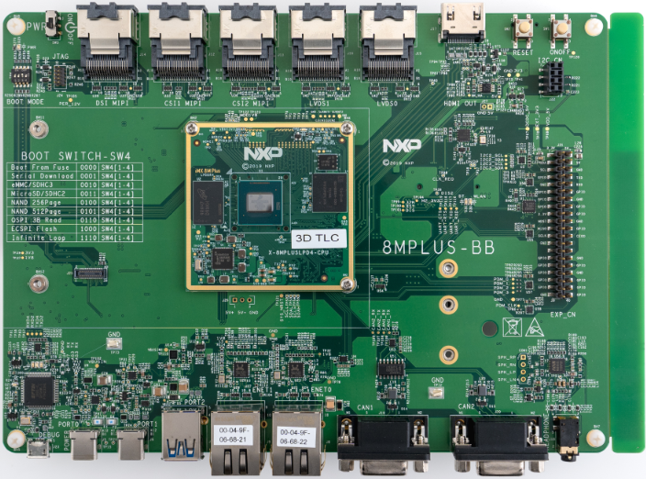
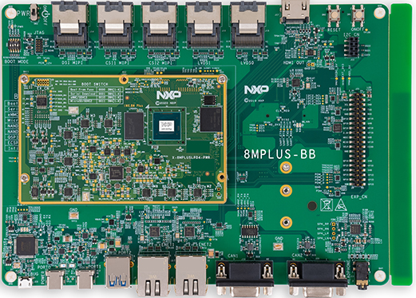
i.MX 8M Plus New Variants Collaterals
Available Now!
Evaluation Kit and PMIC
8MPLUSLPD4-EVK
8MPLUSLPD4-PEVK
PMIC – PCA9450CHN
Samples:
Fully featured part numbers - MIMX8ML8DVNLZAB/MIMX8ML8CVNKZAB
Order samples via nxp.com
Lead time are ~16 weeks (subject to change)
Software & Documentation:
Device support included in Linux BSP releases
FreeRTOS – Available in Q4’24
Windows 10 IoT – Not supported
Updated datasheet available on nxp.com
Notes:
EVK –
Samples
Software support -

Slide 7
Success Story
i.MX 8M Plus
Barcode scanner
Market Segment | Industrial
Application | Machine Vision /Inspection/Bar Code Scanner
Region | South Asia Pacific
IIoT Device | MIMX8ML5CVNKZAB
Competitor | TI, Novatek
Attach Product | PCA9450CHN (PMIC), PTN5150HXMP, SE97BTP (IC USB HOST CTLR),547 (DDR Memory Module Temp Sensor with Integrated SPD).
Why have we won?
Need for defeatured, lower cost i.MX 8M Plus like performance. The MIMX8ML5CVNKZAB (NPU, GPU, VPU but no ISP and Hi-FI4) offered key features required by the customer (performance + NPU) at a lower price point than the fully featured.
Specifications supported this win,
4x Arm® Cortex®-A53 @ 1.6 GHz and Arm Cortex-M7 @ 800MHz
2.3 TOPs NPU
Video Processing Unit
Industrial Qualification

Slide 8
Summary
Four new i.MX 8M Plus Derivatives
Focused application segment
Hardware and software enablement
High Performance with NPU, VPU and rich peripherals
Industrial & Commercial Qualified
Machine Vision, AI/ML and Multimedia
EVK, PMIC, Linux BSP support and datasheet available

